Slide 1

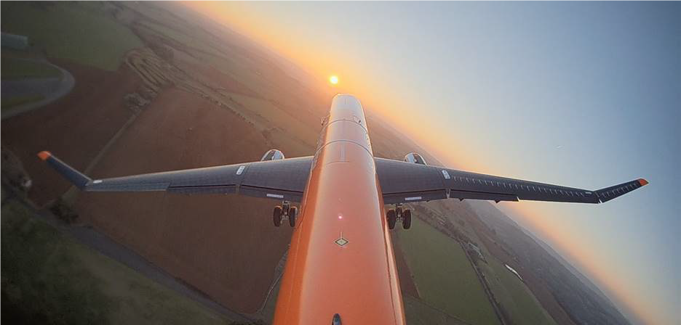
Francesco Marzagalli Supervisor: Prof Joseph Morlier 19th June 2020
PIR – Project innovation et recherche
Hinged wingtip modelling in NeoCASS based on Airbus AlbatrossONE

Slide 2
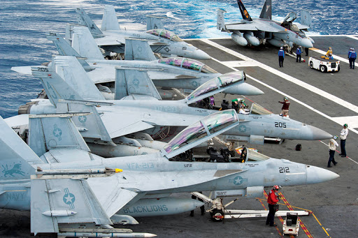
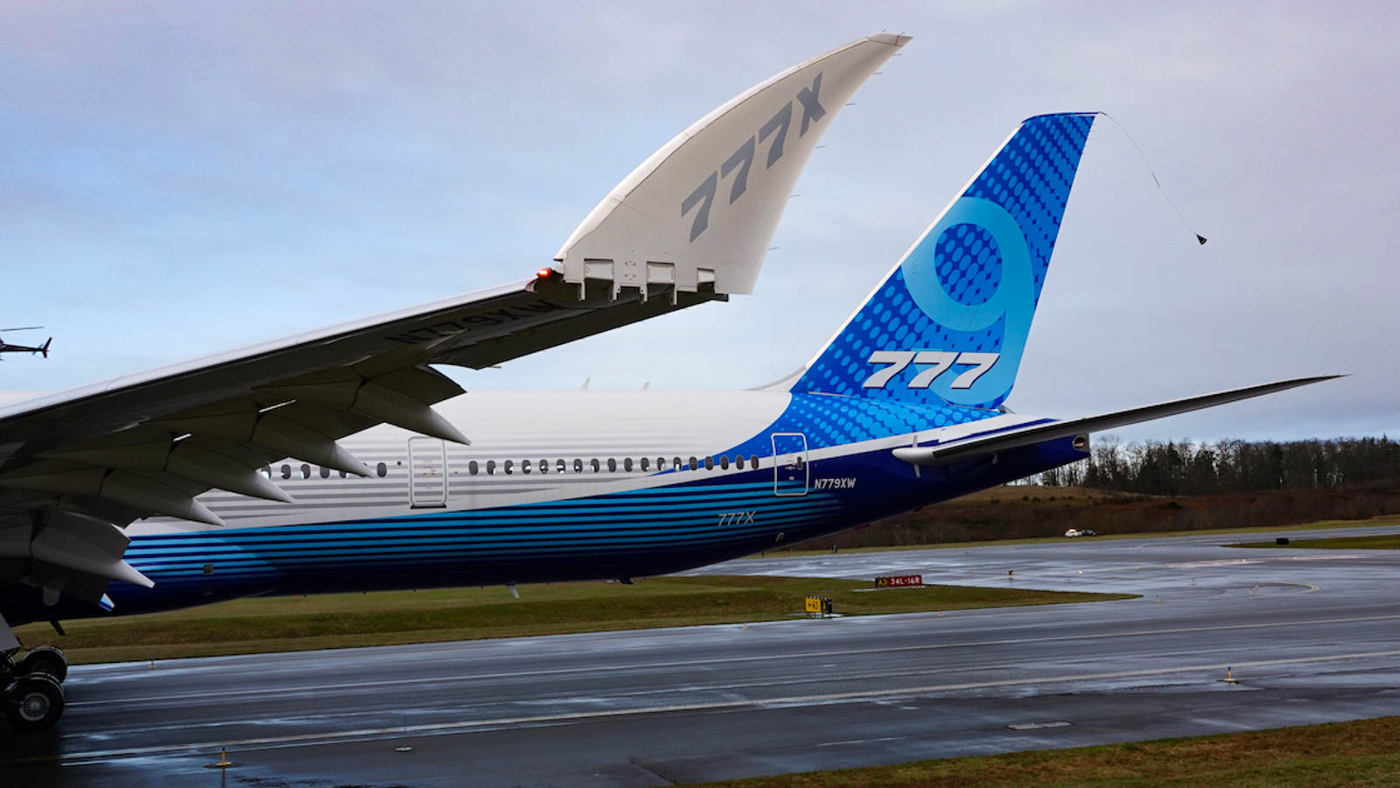
The Hinged Wingtip
Folding wingtips are well known in aeronautics, they have been mainly exploited to save up space in aircraft carriers.
Even civil aviation is starting to consider them, as the new B777 proves. The challenge is now exploiting this feature to obtain further advantages.

Slide 3
Much theoretical work has been done during the last years to prove that hinged wingtips could bring load alleviation in case of manoeuvre and gust or turbulence. Even performance can be enhanced as the hinged device allows an extension in wing span and aspect ratio, which is fundamental to decrease induced drag. [1]
BackGround and Objectives
The project purpose is to model the hinge behaviour into NeoCASS and to reproduce the effect of the hinged wingtip.
Focus has been given both on hinge position and rotational stiffness.
[1] cfr. Bibliography report

Slide 4
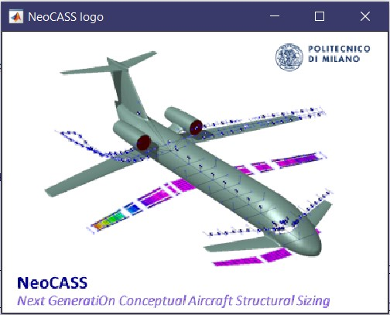
Working Environment
NeoCASS, a suite of Matlab modules to to deal with all the aspects of the aero-structural analysis of a design layout at conceptual design stage, is the working environment for this research.

Slide 5
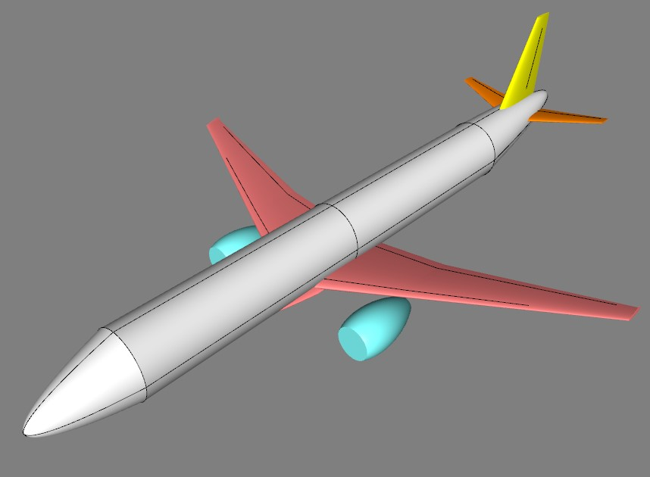
Baseline Model
Different sources have been considered to reproduce the main features of an A321 in ACbuilder, where geometry, mass distribution ad material are defined.
Since lack of specific data was sometimes run into, qualitative choices have been made
(i.e. airfoil)
- Airbus. A321 Aircraft characteristics, airport and maintenance planning
- EASA. Type certificate data sheet for Airbus A318-A319-A320-A321

Slide 6
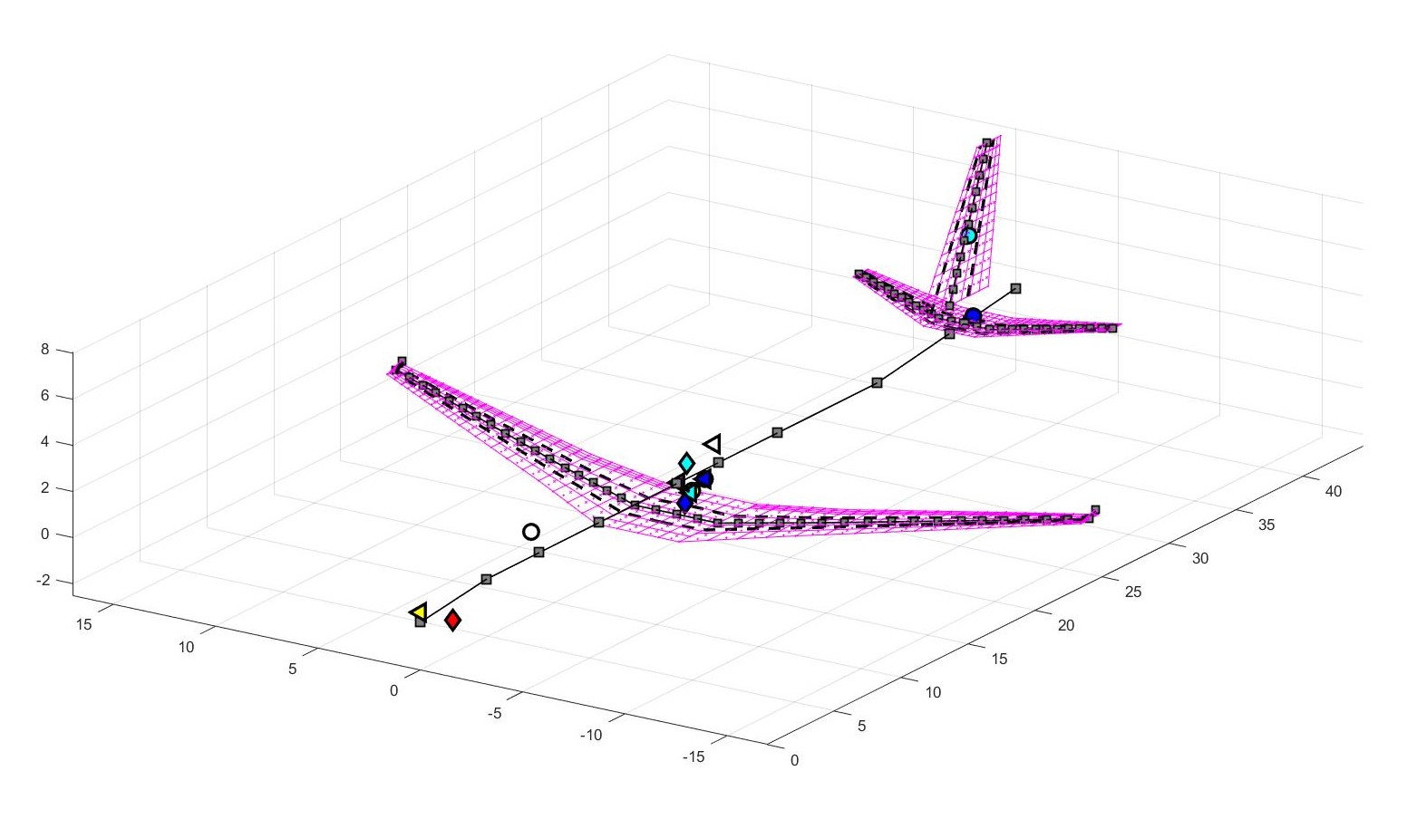
Once exported the model in a .xml file, the sizing manoeuvres have been defined following EASA standards, the main GUESS outputs are a beam stick model and the aerodynamic mesh.

Slide 7
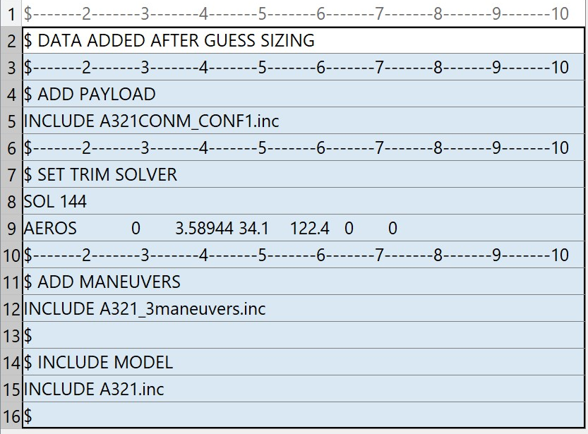
Trim Analisys
Three maneuvers have been taken into consideration:
Cruise,
2g Pull-up,
Sideslip.
All the information required are stored in a .dat file with other aircraft parameters
NASTRAN FORMAT

Slide 8
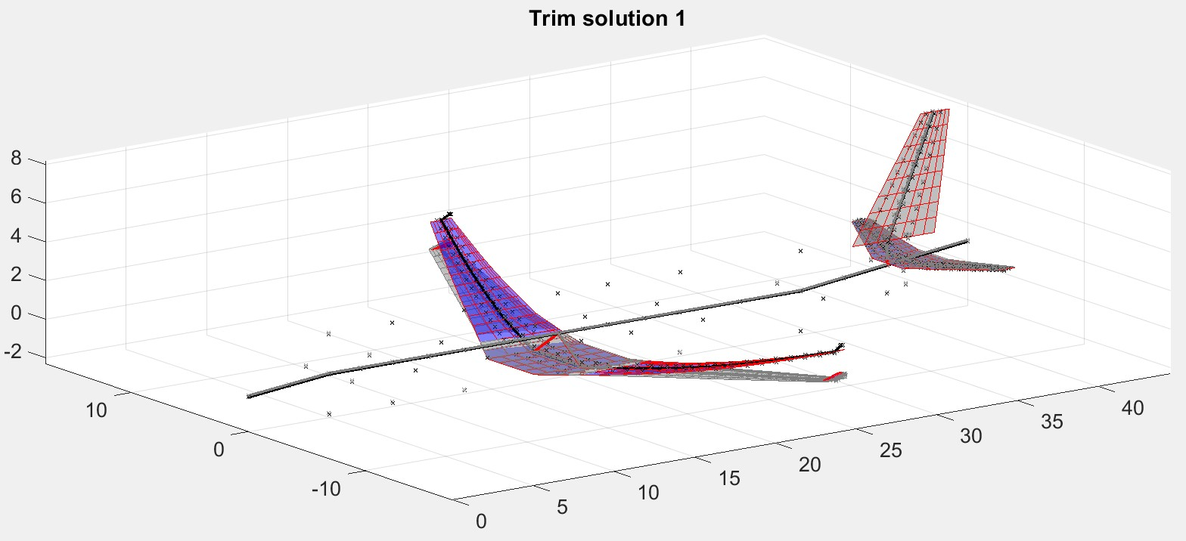
A few Code Lines
global beam_model
input_file = 'A321_input3Trim.dat'
beam_model = load_nastran_model(input_file);
solve_free_lin_trim('INDEX', 1);
plotLinearDispl(beam_model, beam_model.Res, 1, 1)

Slide 9
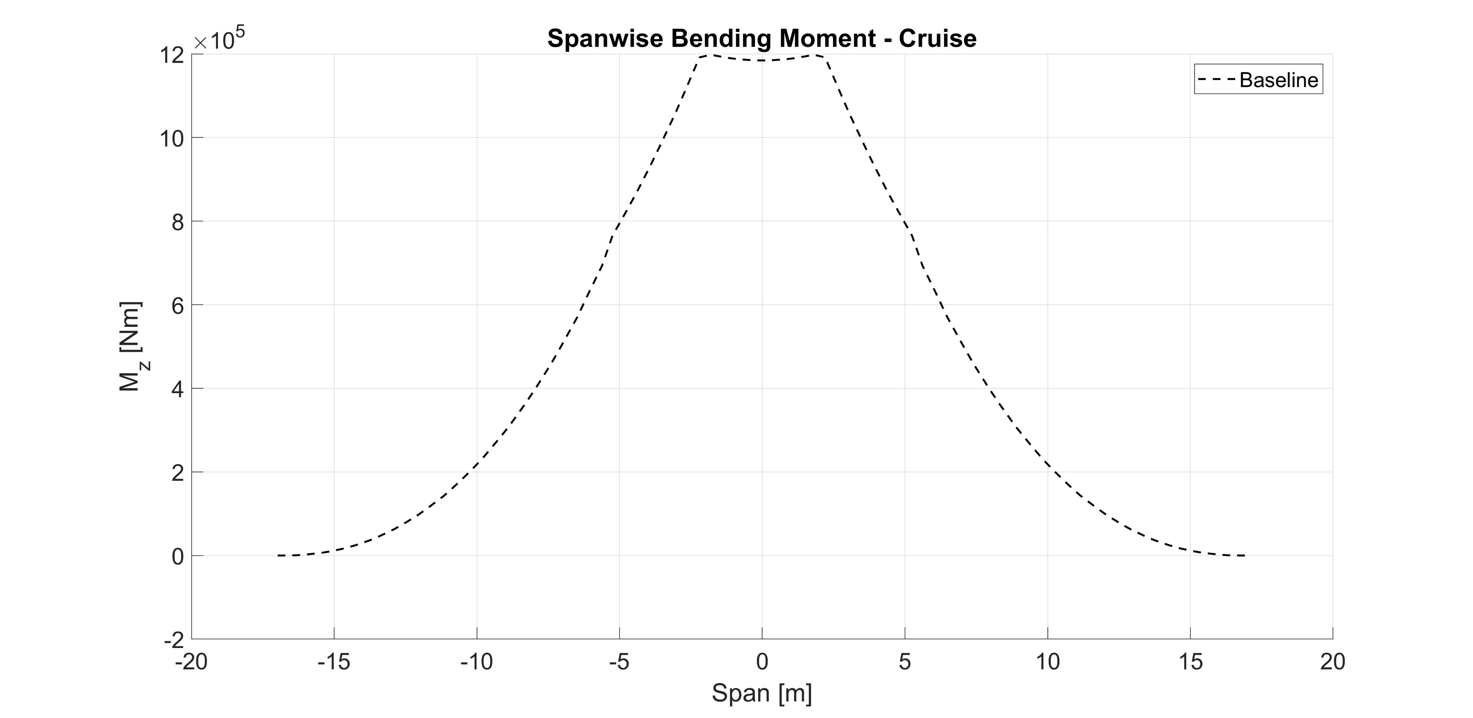
With some post-processing internal forces can be extracted, for example the spanwise Bending Moment has showed to be of critical importance in this kind of analysis.

Slide 10
Gust Analysis
Gust analysis is a little more demanding, but the principles are the same as the trim one, a dedicated SMARTCAD is needed, with all the aircraft features, gust definition ( standard 1-cos) and dynamic analysis parameters.
$ Gust input
$-----2-----3------4-----5-----6-----7-----8-----9-----10
GUST 1 15.00 0.5 0 3 FUN
1
(1-cos(2*pi/0.5*t))*0.5
NASTRAN FORMAT
global beam_model
global dyn_model
input_file = 'A321_inputGust.dat';
init_dyn_model(input_file)
solve_free_lin_dyn('dT', 5e-3, 'Tmax', 6);

Slide 11
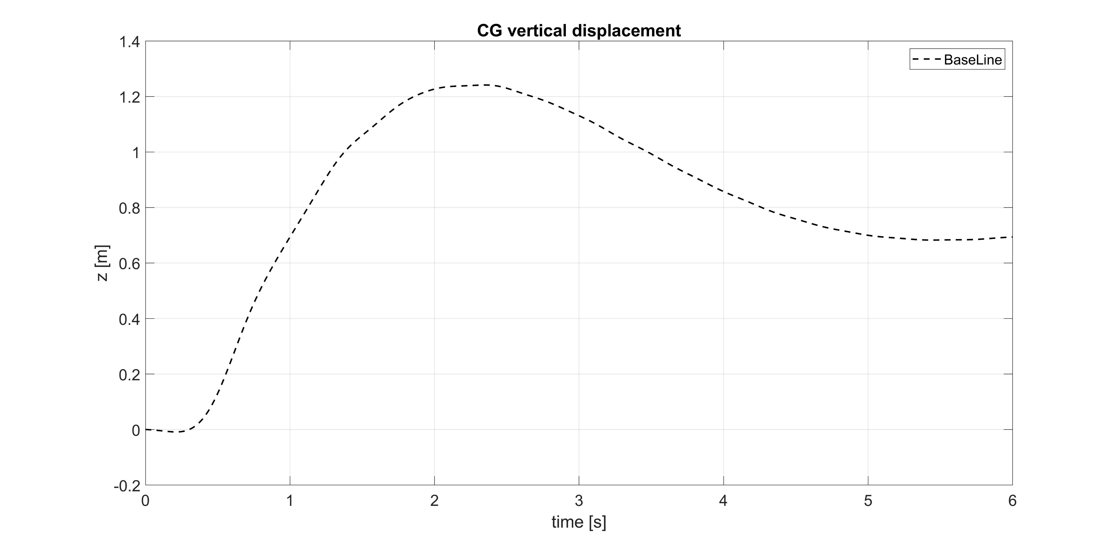
Main results can be extracted by post-process commands, for example CG vertical displacement:

Slide 12
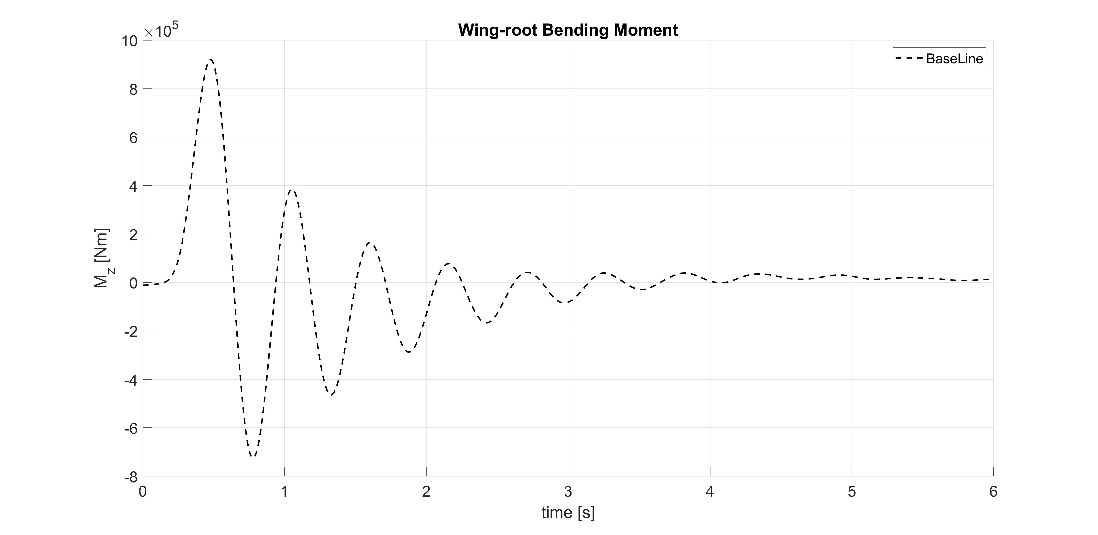
Focus is given on the wing-root bending moment and its evolution in time :

Slide 13
The Hinge Device
A second model has been built to investigate the effects of a increased wingspan (+25%), while the other characteristic were the same as the baseline model.
Once the Guess sizing was completed one output was a file in which the stick beam model, nodes and bars are defined.
The idea to reproduce the hinge behaviour is modifying the definition of the node set in order to introduce an elastic coupling, to make the wingtip free to fold.

Slide 14
Nodes and beam definition
GRID 2011 0 22.9742 13.246 -0.125720 0 0
GRID 2012 0 23.4643 14.4853 0.0057630 0 0
GRID 2013 0 23.9543 15.7245 0.1372530 0 0
GRID 2014 0 24.4443 16.9637 0.2687420 0 0
GRID 8001 0 24.4443 16.9637 0.2687420 0 0
GRID 2015 0 24.9923 18.3193 0.4103 0 0 0
---------------------------------------------------------------------
CBAR 2012 2012 2012 2013 0.008394-0.109410.99396 GGG
CBAR 2013 2013 2013 2014 0.008394-0.109410.99396 GGG
CELAS 8001 1e15 2014 1 8001 1
CELAS 8002 1e15 2014 2 8001 2
CELAS 8003 1e15 2014 3 8001 3
CELAS 8004 K 2014 4 8001 4
CELAS 8005 1e15 2014 5 8001 5
CELAS 8006 1e15 2014 6 8001 6
CBAR 2014 2014 8001 2015 0.008394-0.109410.99396 GGG
CBAR 2015 2015 2015 2016 0.008394-0.109410.99396 GGG
CBAR 2016 2016 2016 2017 0.008394-0.109410.99396 GGG
CBAR 2017 2017 2017 2018 0.008394-0.109410.99396 GGG

Slide 15
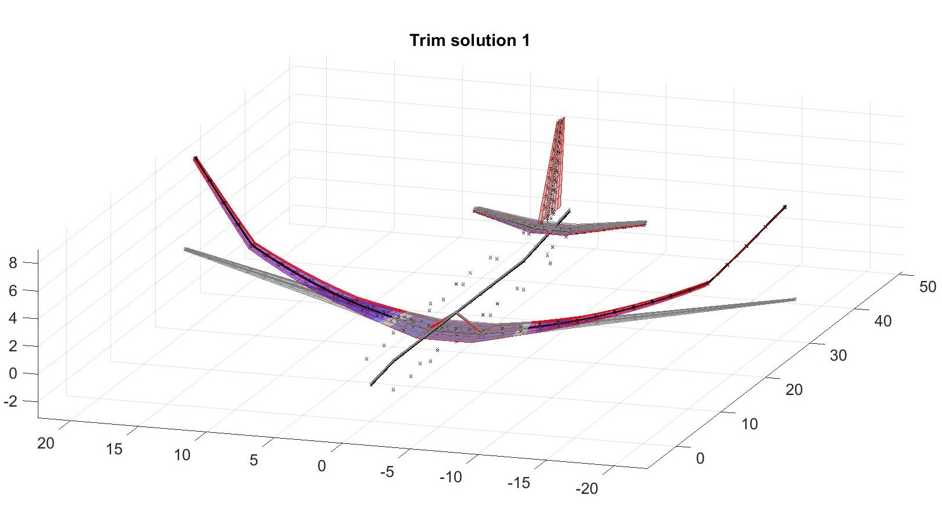
Hinged Wingtip
By analysing the trim in cruise it is evident that the implemented idea works as the wingtip folds independently wrt the remaining part of the wing:

Slide 16
Hinge Position and Rotational Stiffness
Different hinge position were then taken into consideration:
75%, 81%, 84%, 88%, 93% of the wingspan
And different values for the rotational stiffnesses too:
1e+03 Nm/rad, 1e+04 Nm/rad, 1e+05 Nm/rad, 1e+06 Nm/rad
Too low values for the rotational stiffness showed numerical problems and thus weren’t taken into consideration.

Slide 17
Trim Best Results - Cruise
For the sake of clarity among all the configurations only the best one are now presented and compared with the baseline model (no hinge, normal wingspan)

Slide 18
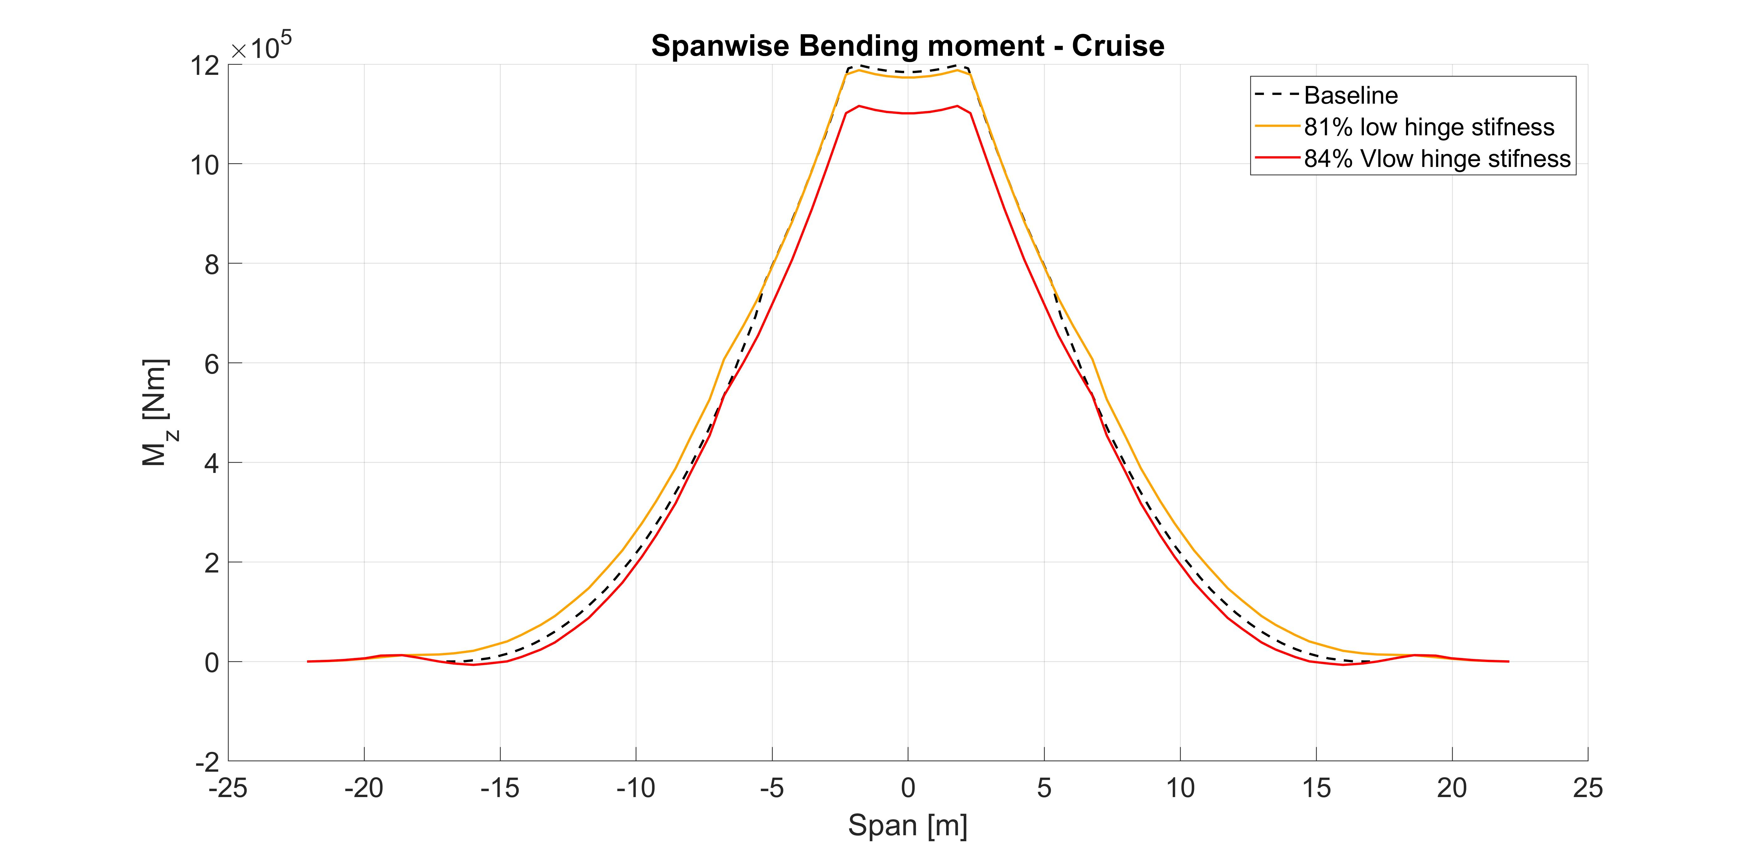
Trim Best Results - Cruise
For the sake of clarity among all the configurations only the best one are now presented and compared with the baseline model (no hinge, normal wingspan)
WRBM comparison:
- 1%,
- 7%
(wrt baseline)

Slide 19
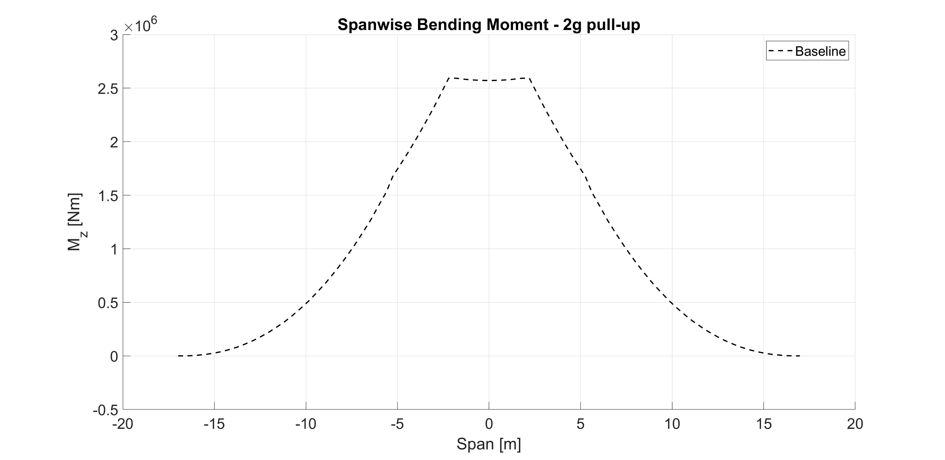
Trim Best Results – 2g Pull-up

Slide 20
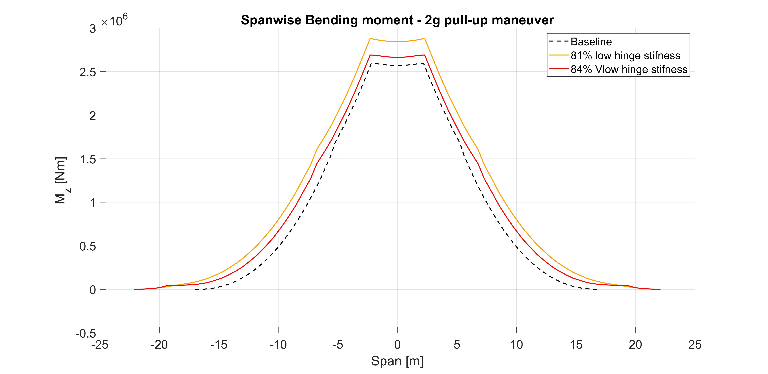
Trim Best Results – 2g Pull-up
Max WRBM comparison:
+ 11%
+ 3.8%
(wrt baseline)

Slide 21
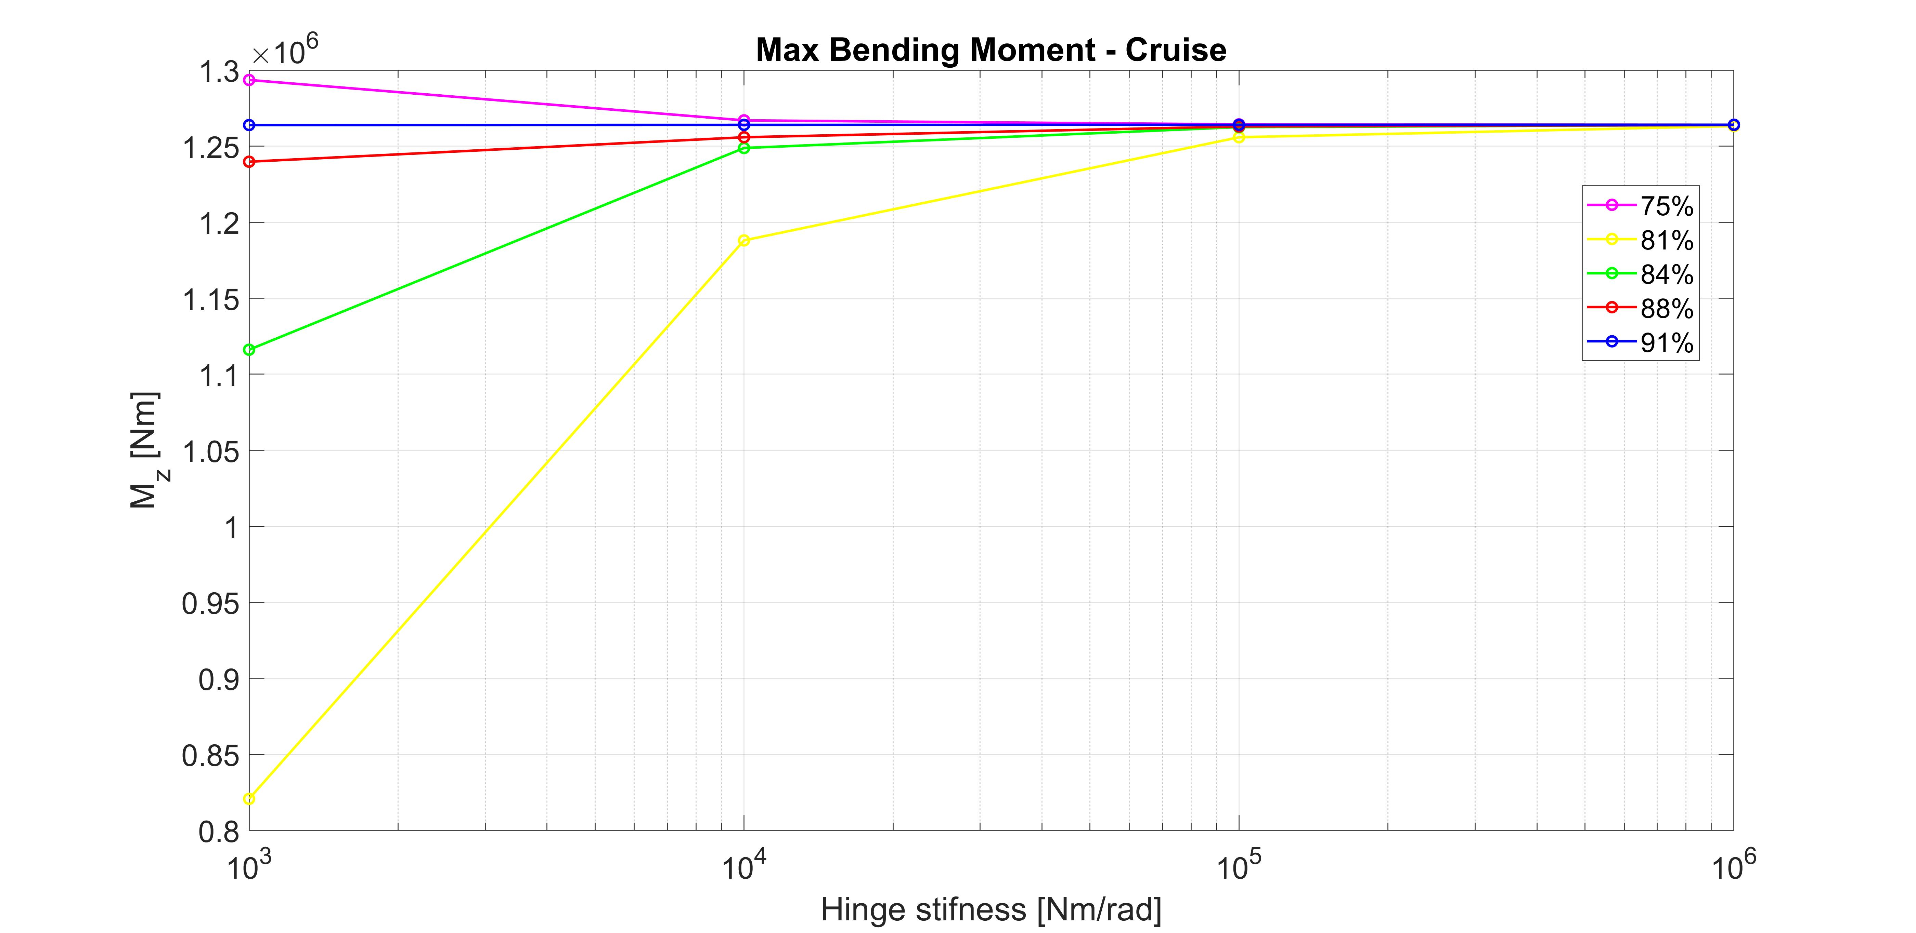
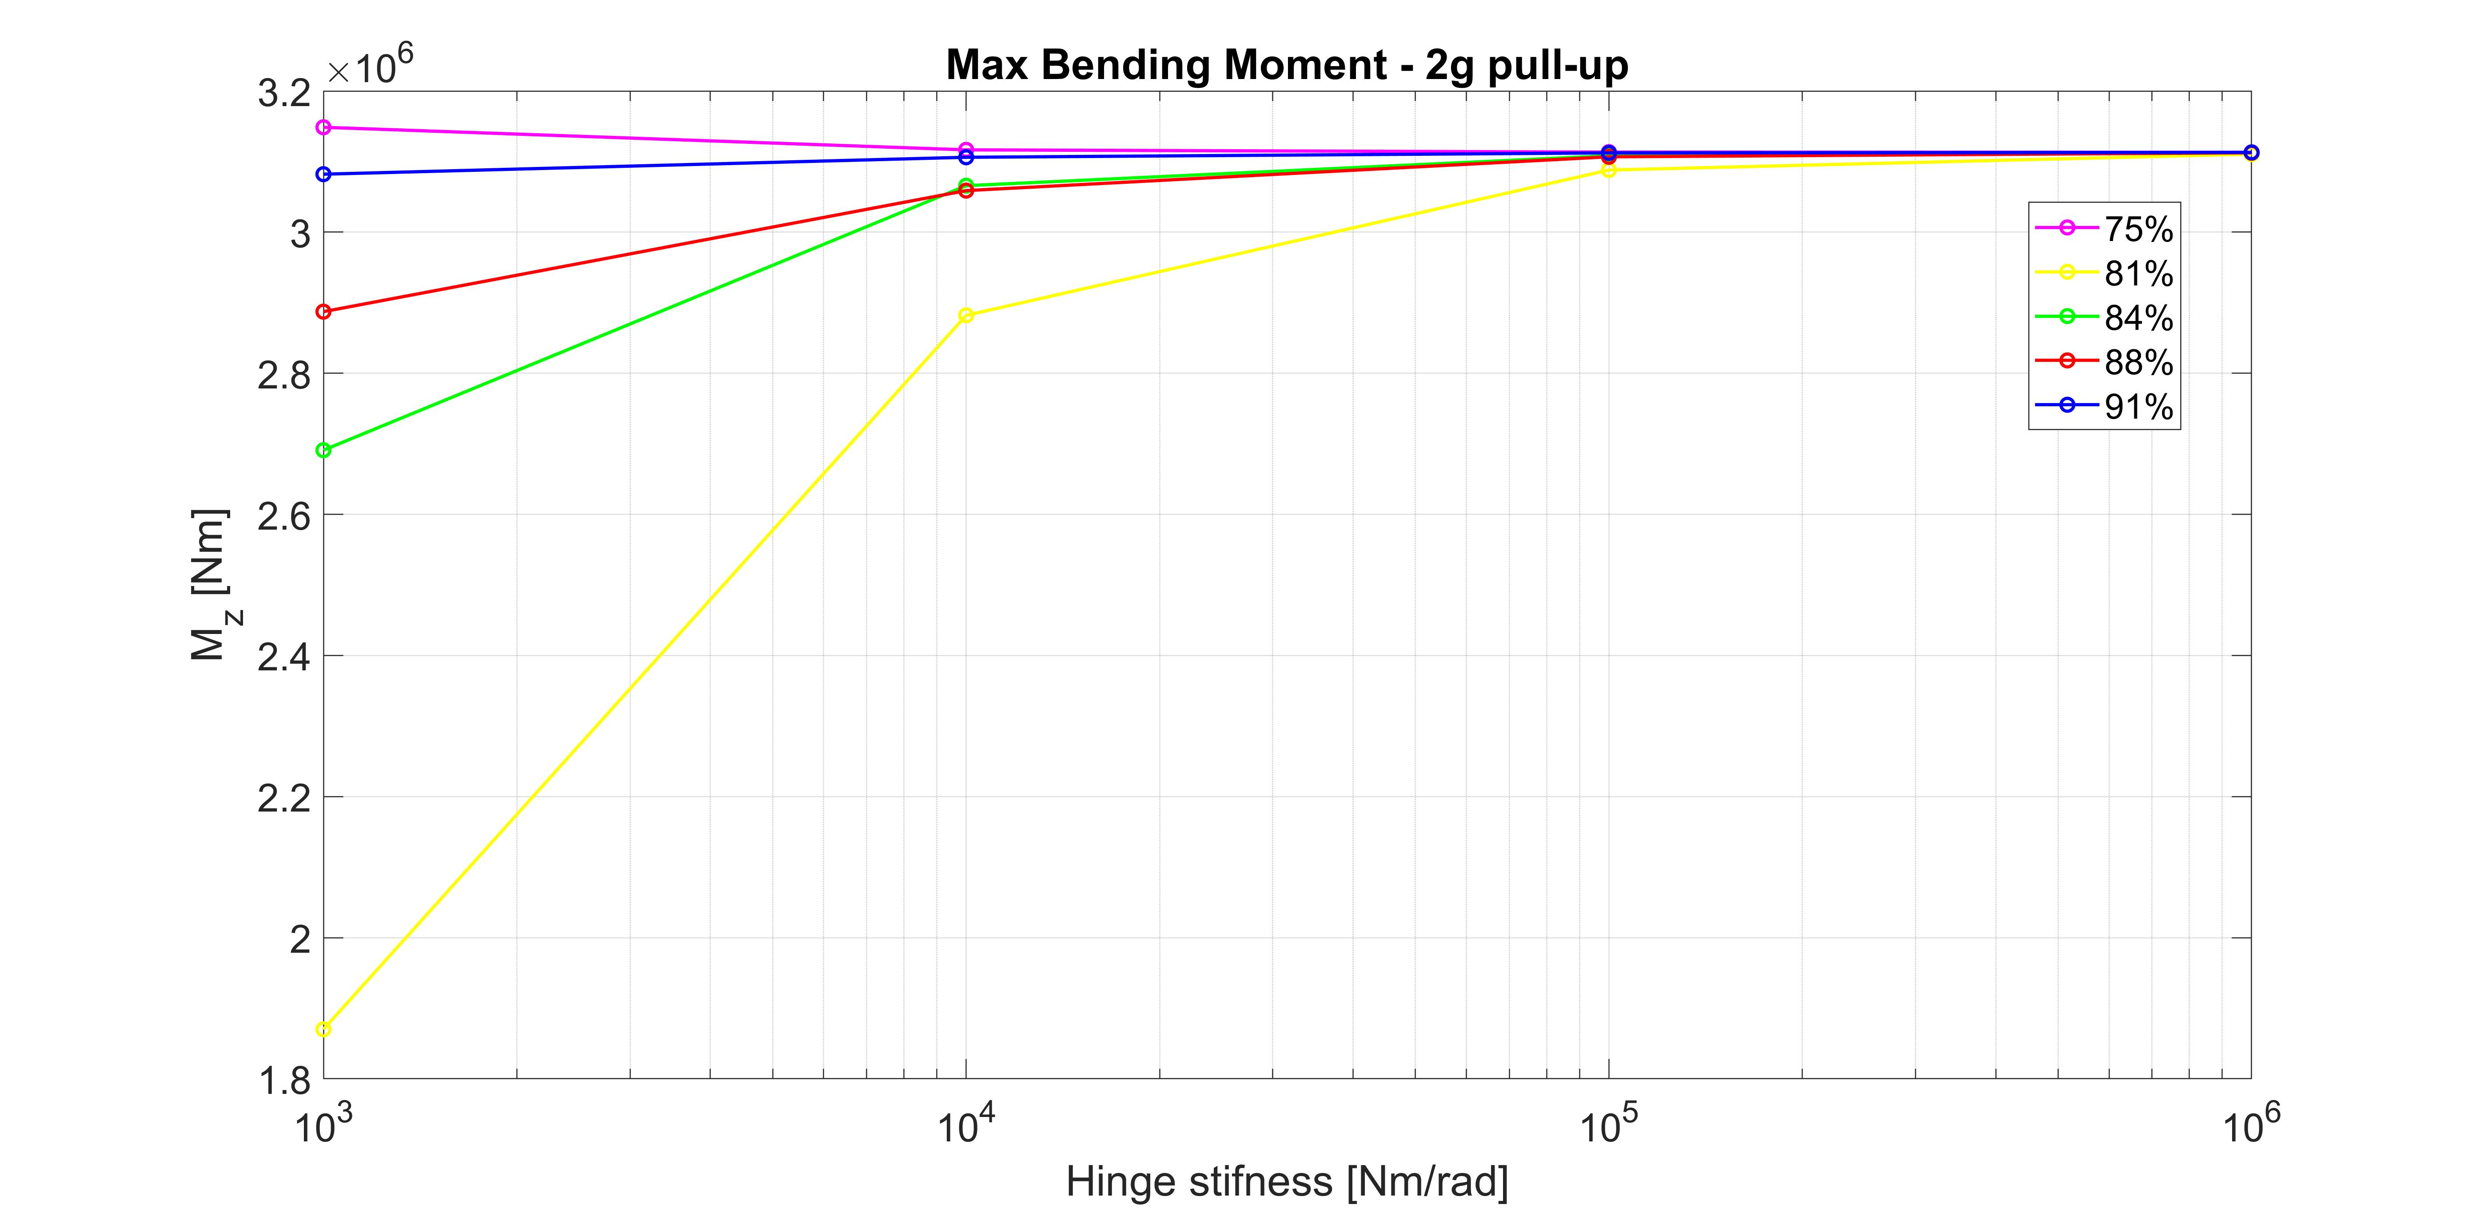
Hinge Position and Stiffness effects
Among the 20 configurations considered the best are those equipped with very low or low stiffnesses
Max WRBM shows a similar trend for both flight conditions, except for one case (hinge at 75%), for increasing hinge stiffness or span position

Slide 22
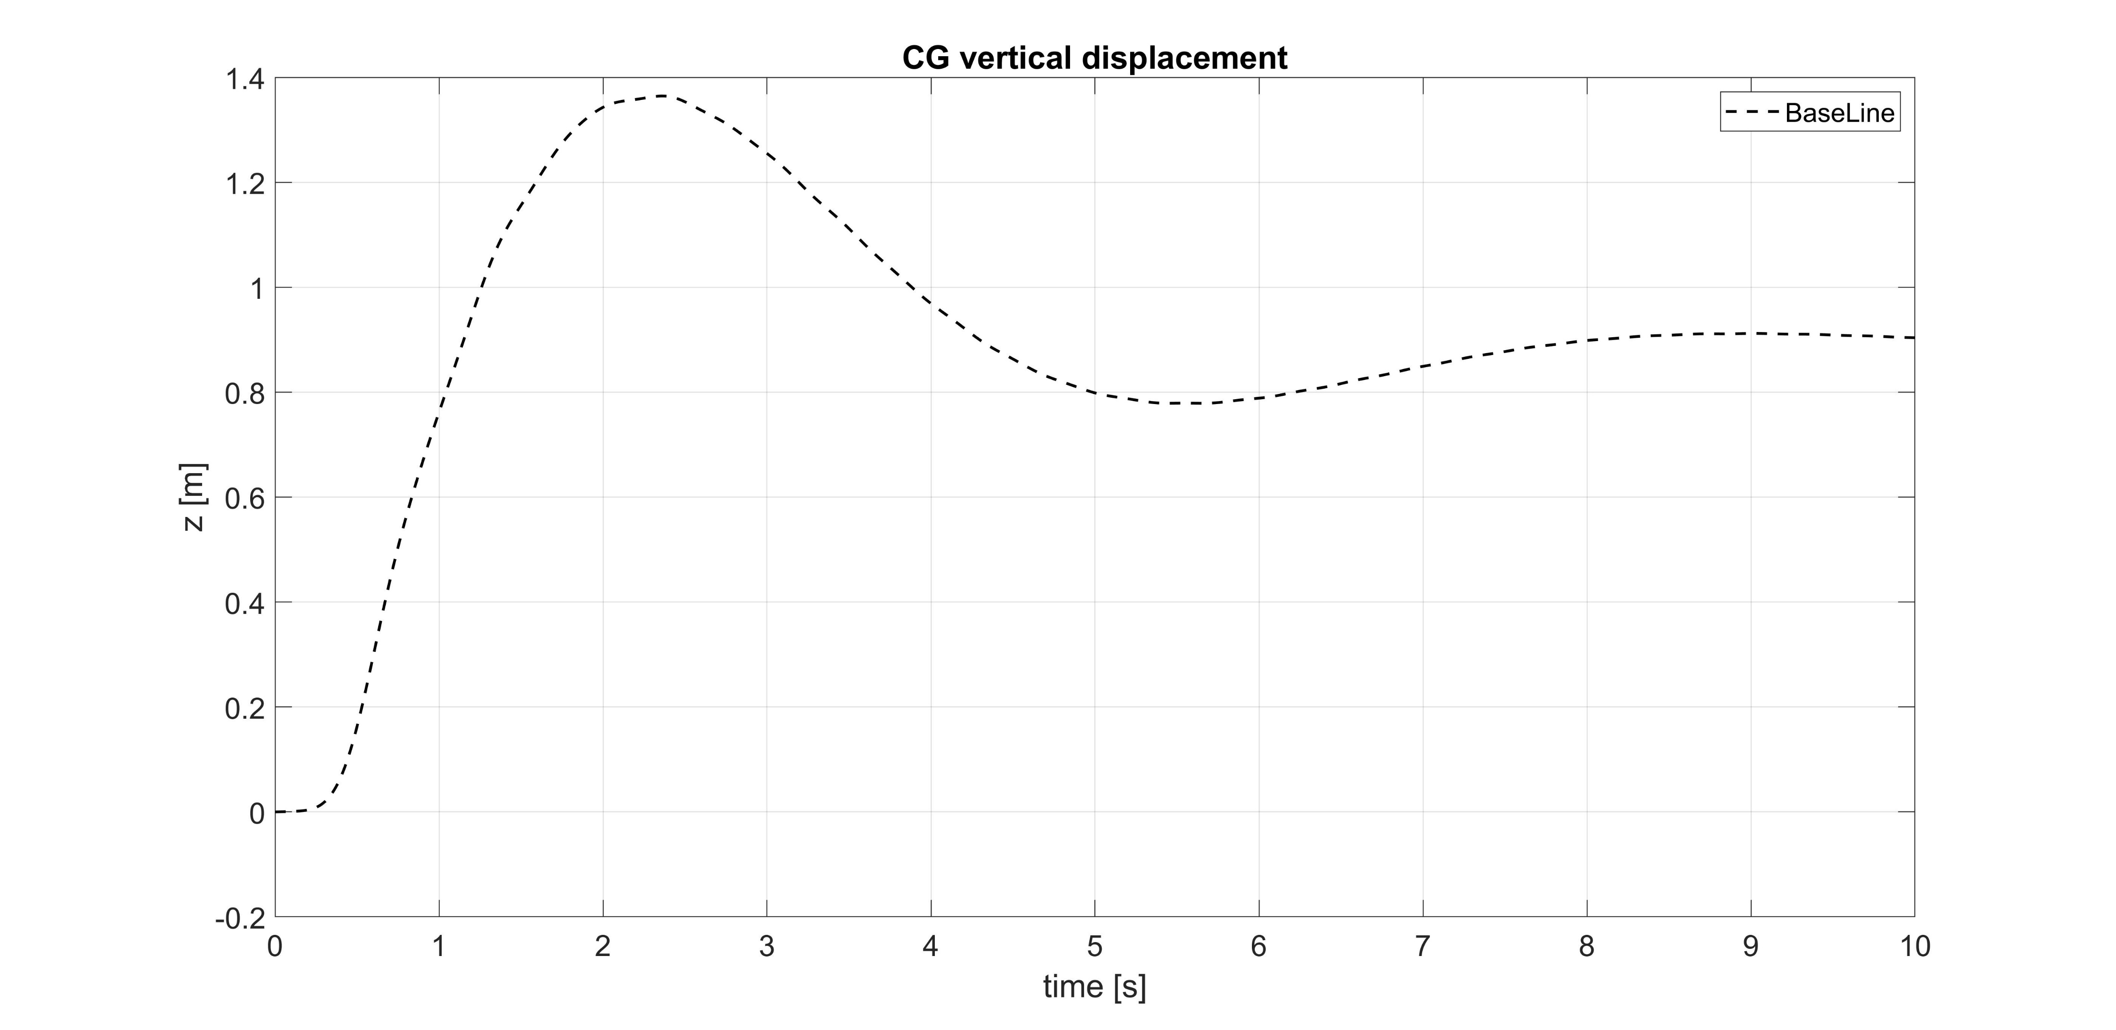
Gust Best Results
Gust best configuration are presented for CG vertical displacement and
Wing-root Bending Moment evolution with time:

Slide 23
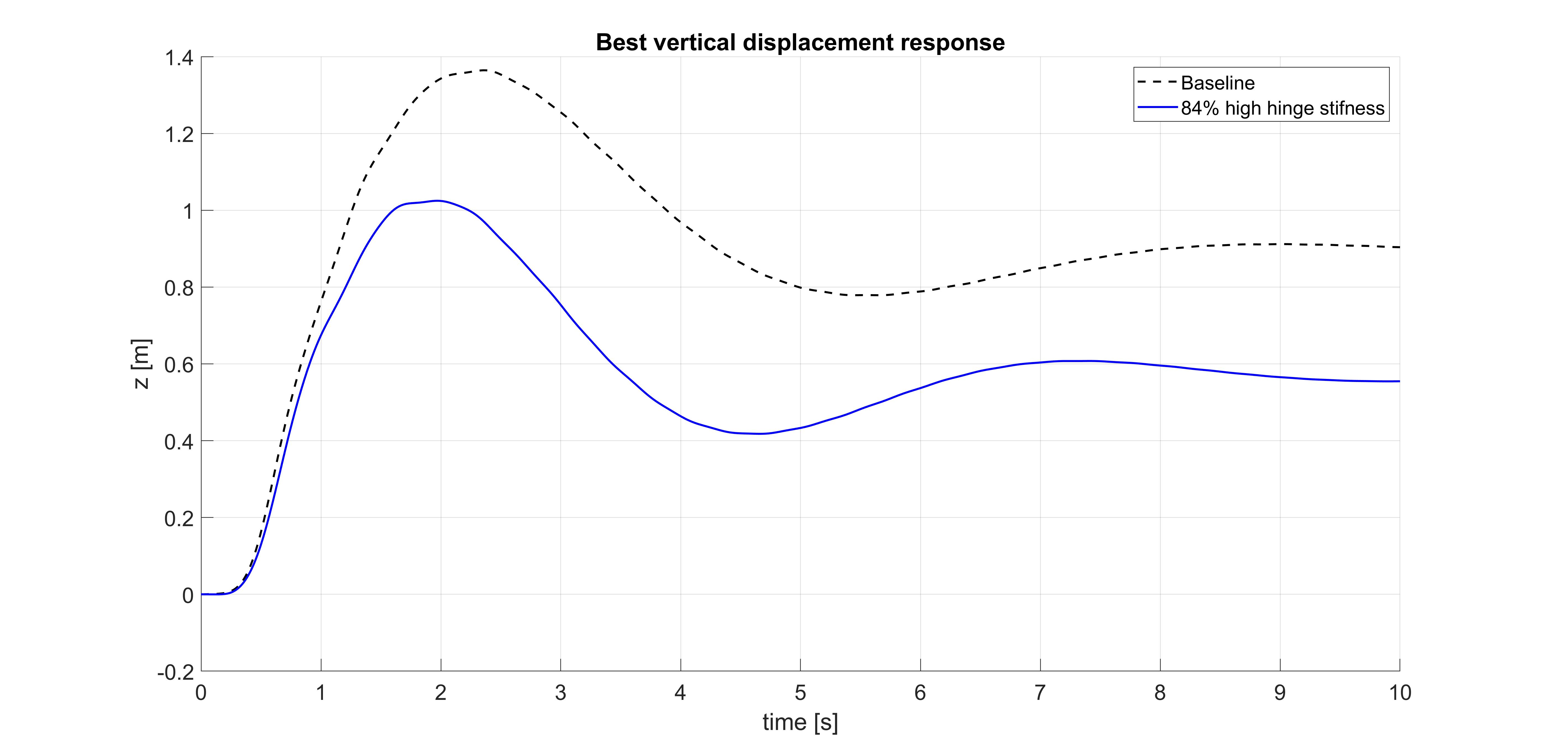
Gust Best Results
Gust best configuration are presented for CG vertical displacement and
Wing-root Bending Moment evolution with time:
Max vertical displacement gain:
-25%

Slide 24
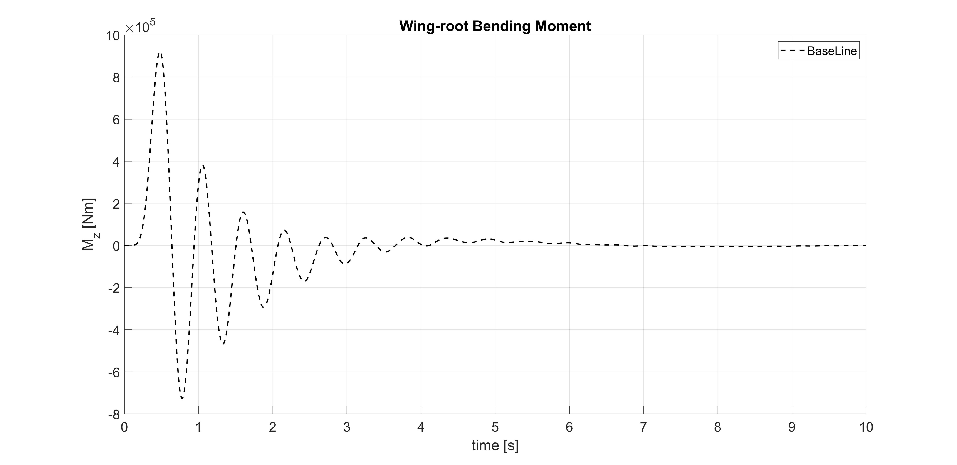
Gust Best Results

Slide 25
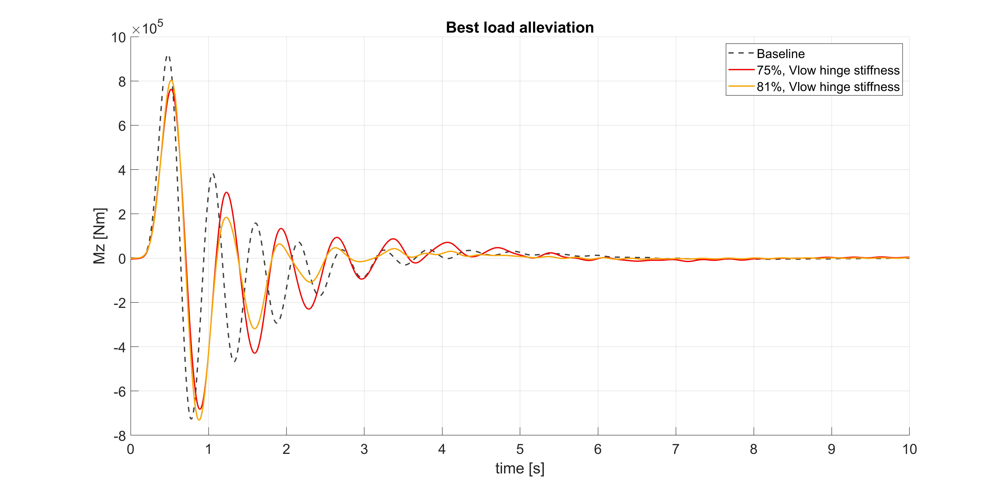
Max WRBM alleviation:
- 13%
- 17%
(wrt baseline)

Slide 26
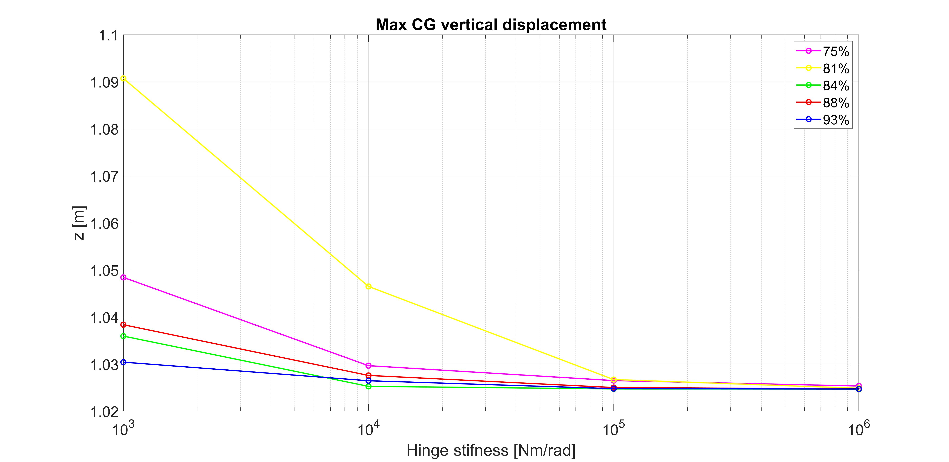
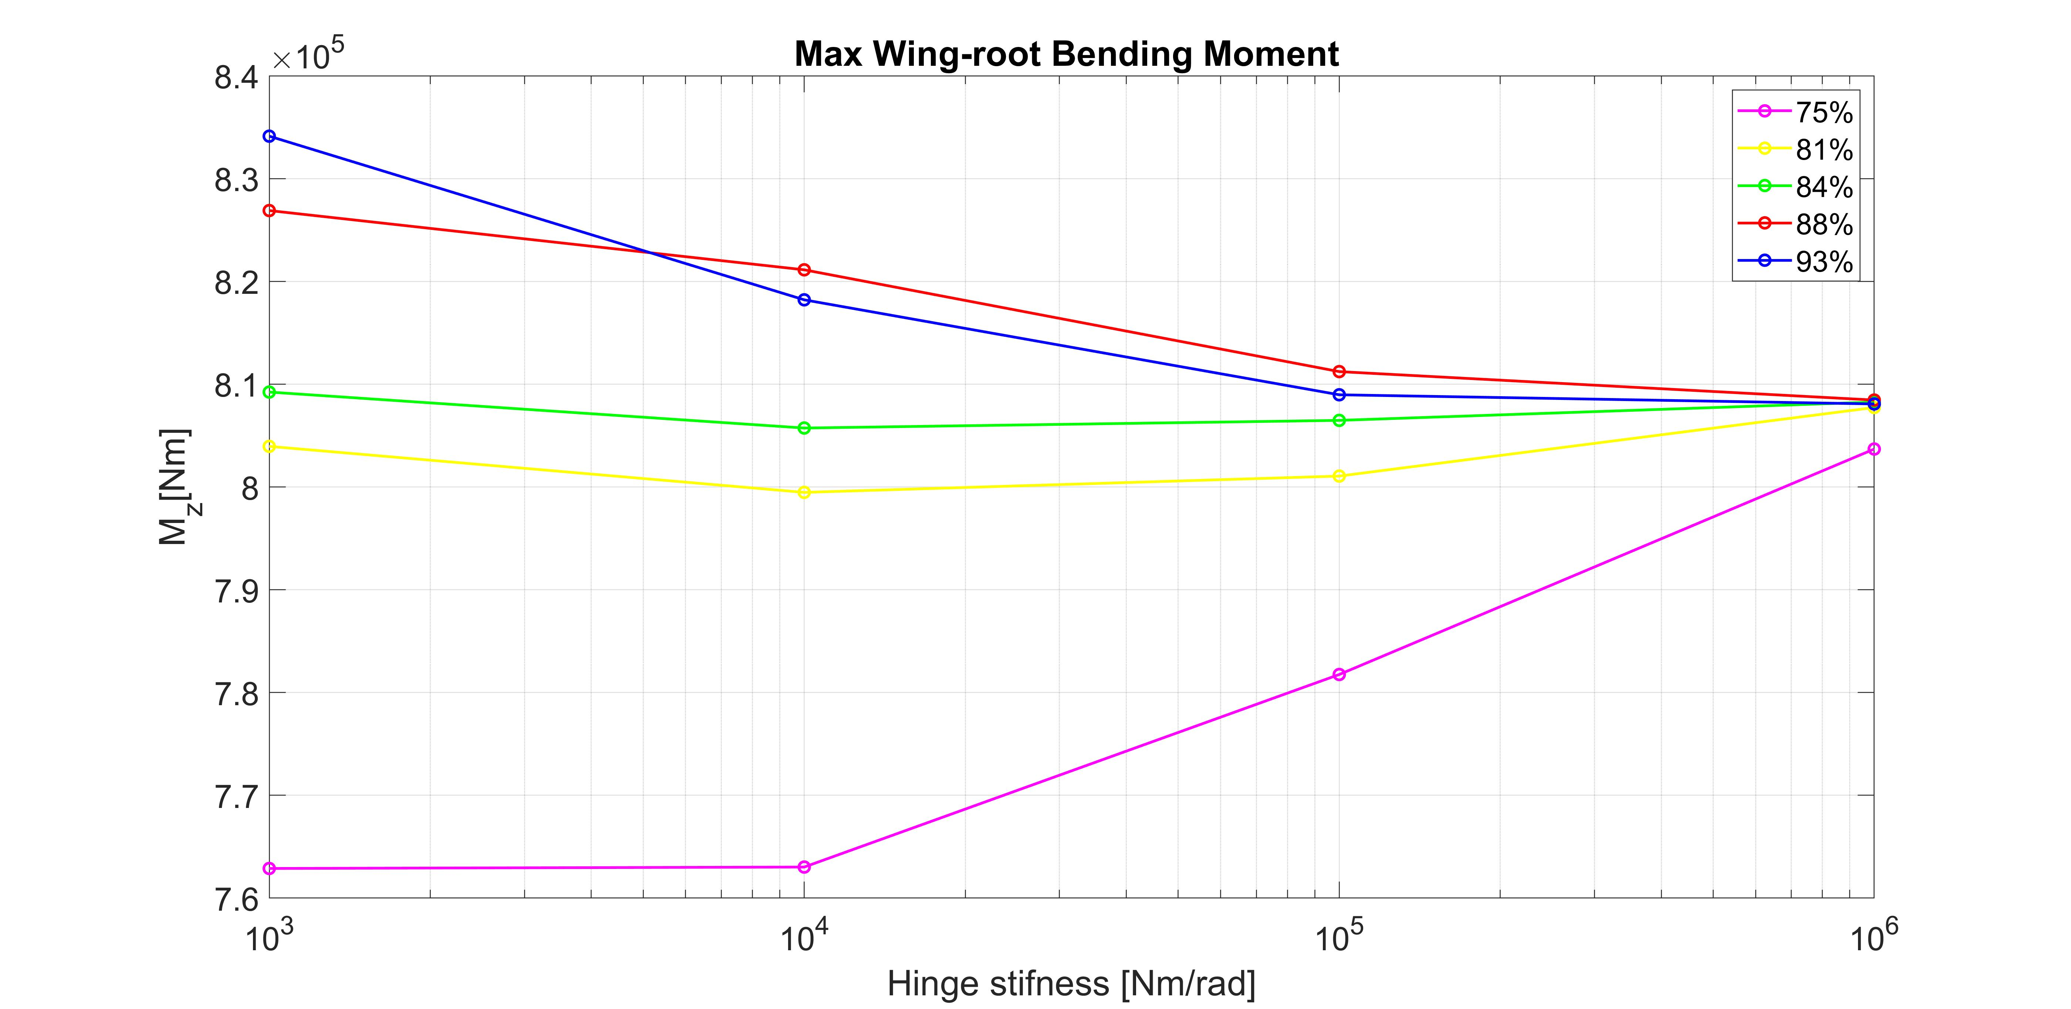
Hinge Position and Stiffness effects
High hinge stiffness proved to be better to minimize vertical displacement for all configurations.
A correlation between hinge position and stiffness can be noted.
Low hinge stiffness proved to be better to minimize vertical displacement for all configuration.
Unfortunately no clear correlation between hinge position and stiffness can be noted.

Slide 27
Conclusions
Trim Analysis showed a clear correlation between hinge stiffness and max WRBM, as previous research had found.
Low stiffness caused the best load response at the wing-root, as expected, while higher stiffness resulted in higher loads.
Cruise and 2g pull up manoeuvre showed similar trend in load evolution.
In Cruise case the best configuration lead to load alleviation which was unexpected.
Gust analysis showed load alleviation for each hinge configuration considered, but no clear correlation between hinge stiffness and position was found.
However, low stiffness was again responsible for the best response, as expected.
The hinged device configuration proved to be beneficial for vertical displacement relief.
As showed, higher stiffness lead to slightly better response in this case.

Slide 28
Francesco Marzagalli
Thank for your precious attention!

Slide 29
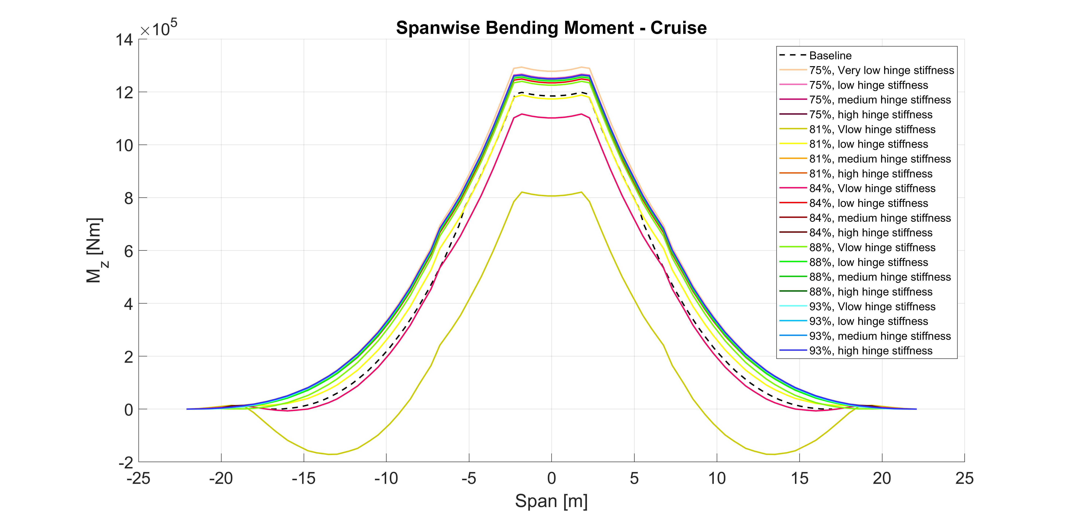
Extra Plots

Slide 30
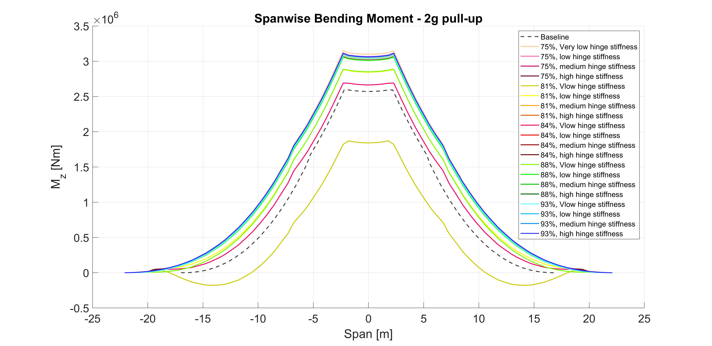
Extra Plots

Slide 31
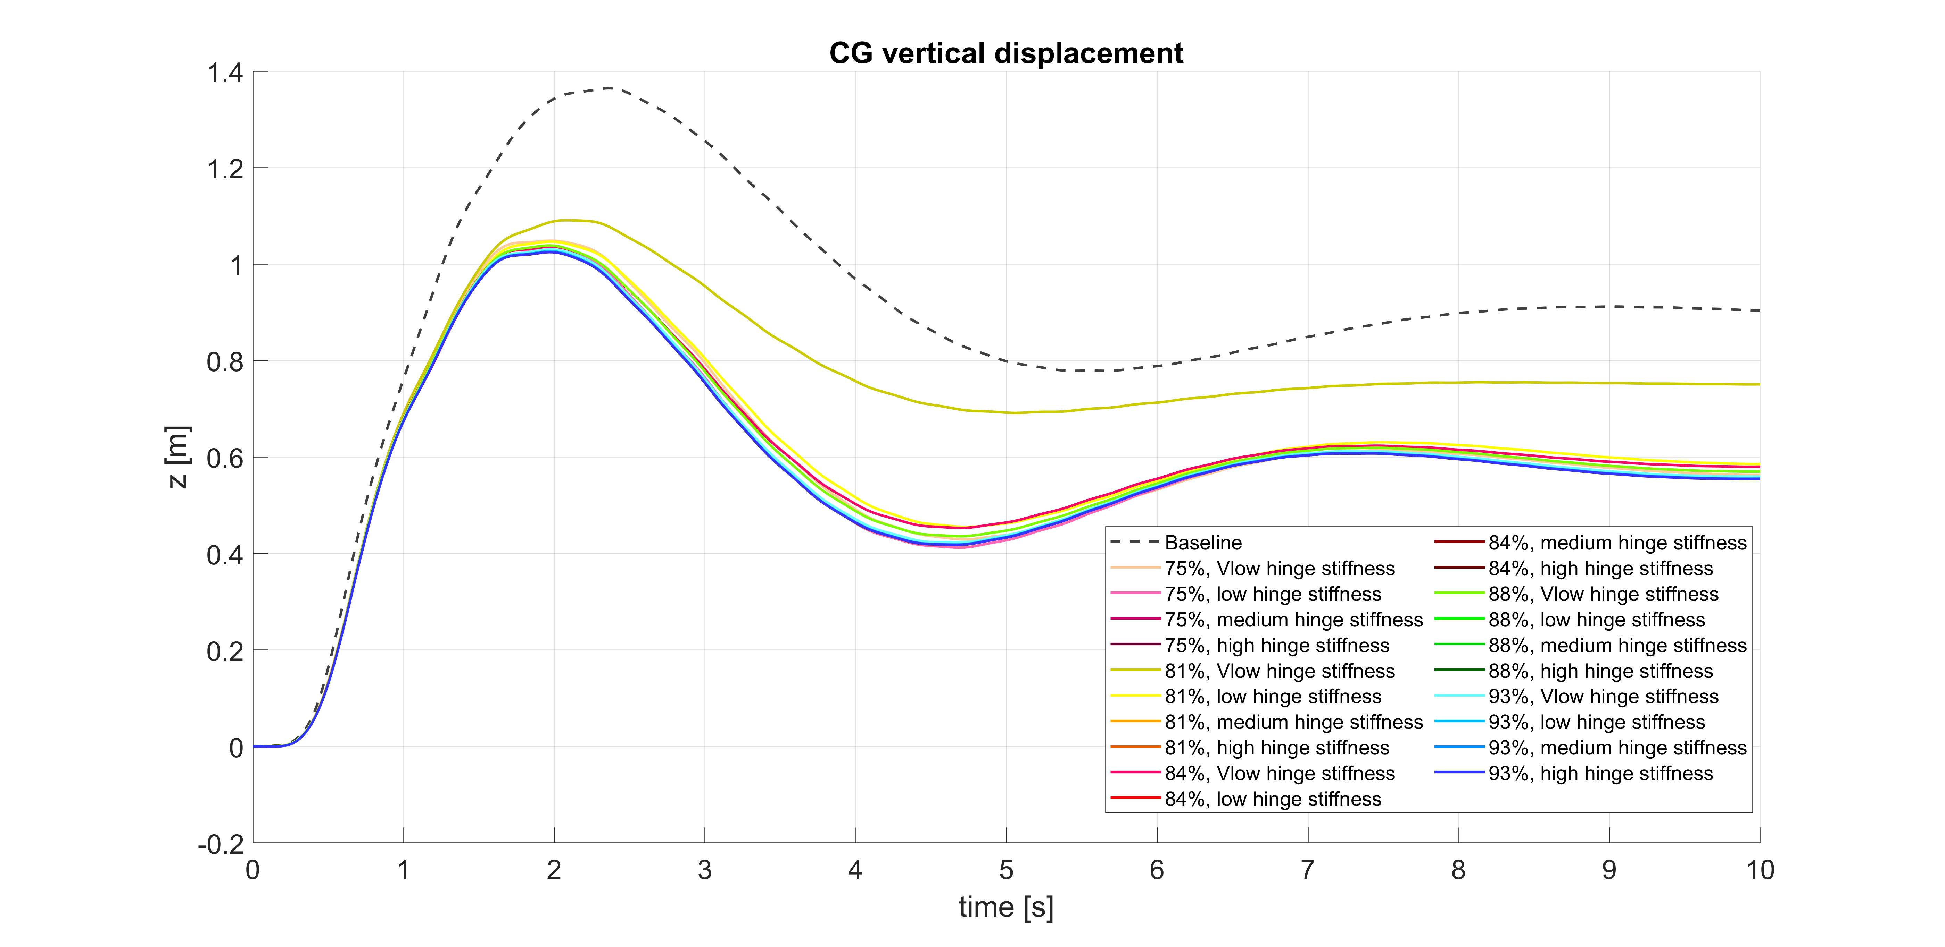
Extra Plots

Slide 32
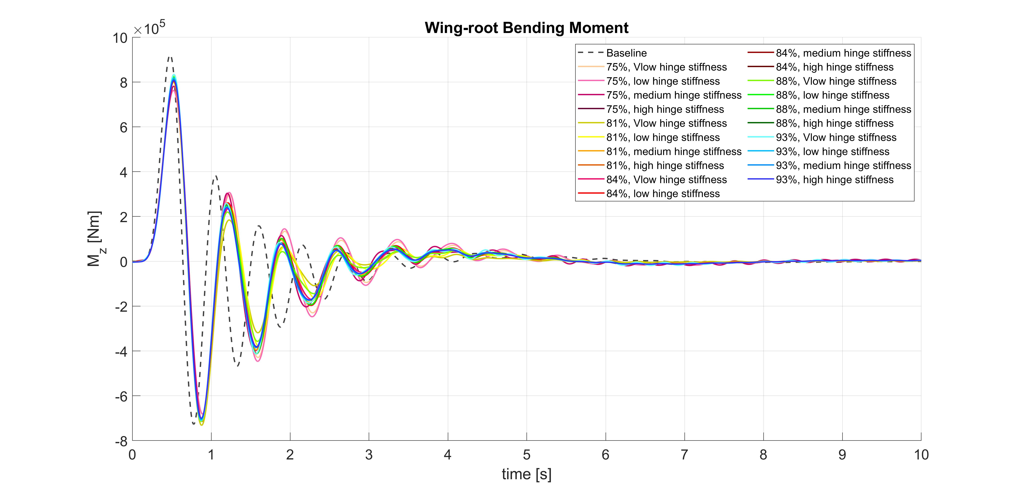
Extra Plots

